Slide 1
Rabin-Karp Algorithm
Substring Search

Slide 2
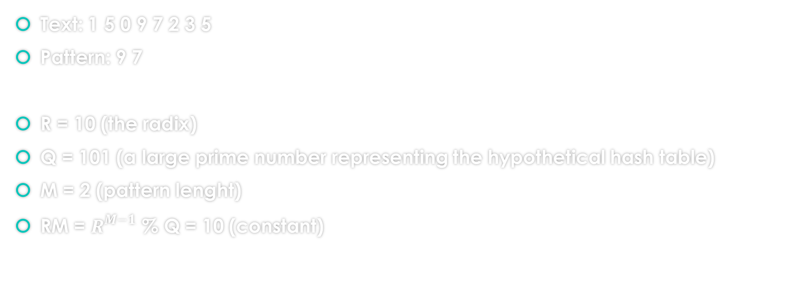
Detailed Running Example
Initialisations
Text: 1 5 0 9 7 2 3 5
Pattern: 9 7
R = 10 (the radix)
Q = 101 (a large prime number representing the hypothetical hash table)
M = 2 (pattern lenght)
RM = $R^{M−1}$ % Q = 10 (constant)

Slide 3
Detailed Running Example
Computing pattern hash value
i | 0 | 1
 | 9 | 7
0 | 9 % 101 = 9
1 | 9 | 7 % 101 = (9 * 10 + 7) % 101 = 97

Slide 4
Detailed Running Example
Computing text hash value
i | 0 | 1 | 2 | 3 | 4 | 5 | 6 | 7
 | 1 | 5 | 2 | 9 | 7 | 2 | 3 | 5
0 | 1 % 101 = 1
1 | 1 | 5 % 101 = (1 * 10 + 5) % 101 = 15
2 |  | 5 | 2 % 101 = ( (15 + 1 * (101 - 10) ) * 10 + 2 ) % 101 = 52
3 |  |  | 2 | 9 % 101 =( (52 + 5 * (101 - 10) )* 10 + 9) % 101 = 29
4 |  |  |  | 9 | 7 % 101 =( (29 + 2 * (101 - 10) ) * 10 + 7) % 101 = 97
Index to be returned: i-M+1 = 4 – 2 + 1 = 3
Match found

